Slide 1
Understand List Books Feature in Front-End
List Books by Category
List Books in Home Page:
New Books – Most recently published books
Best-selling Books
Most-favored Books

Slide 2
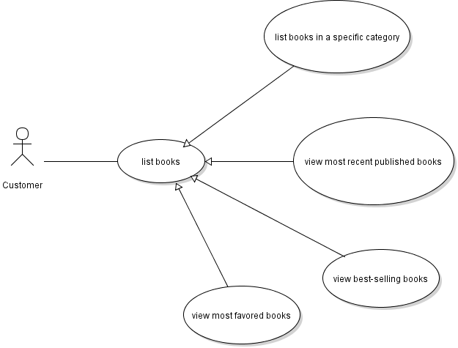
Use Case Diagram

Slide 3
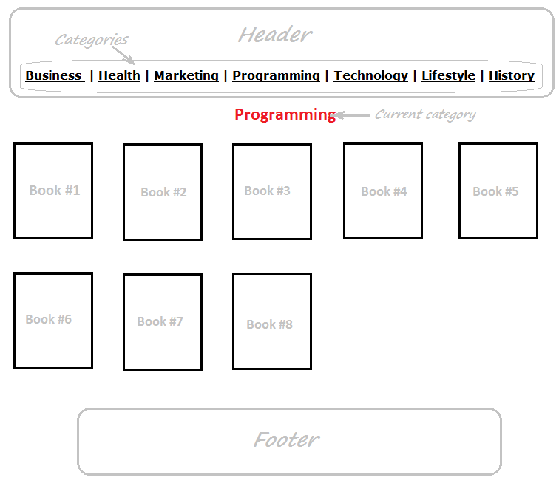
List Books in a Category

Slide 4
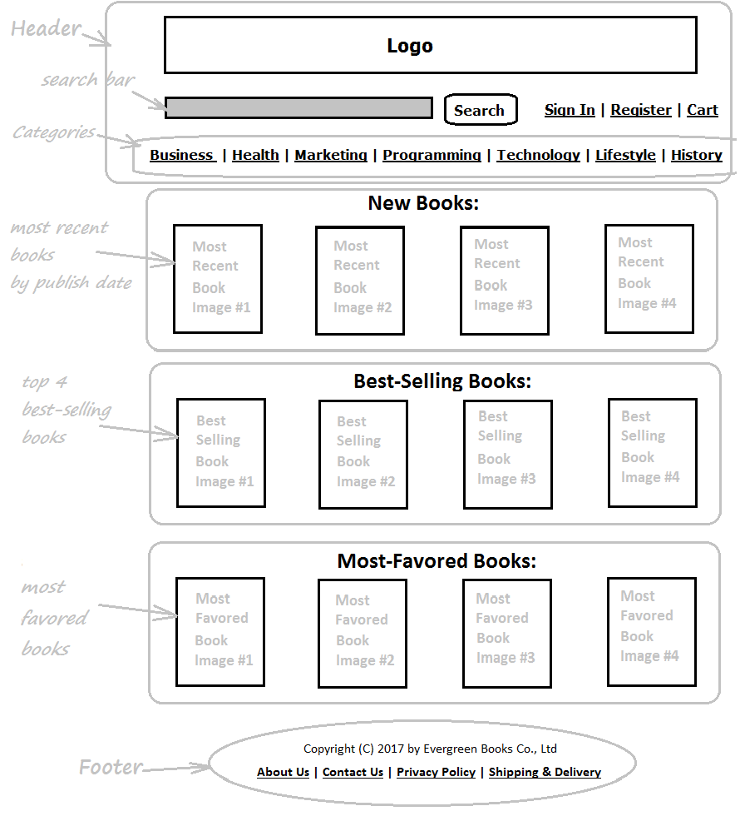
List Books in Home Page

Slide 5
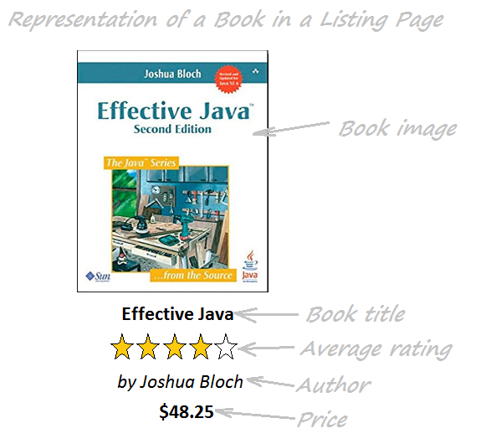
Book in a Listing Page

Slide 6
Implement List Books by Category Feature
Code listByCategory() method in BookDAO Class
Create ViewBooksByCategoryServlet Class
Update BookServices Class
Code List Books by Category Page (JSP)

Slide 7
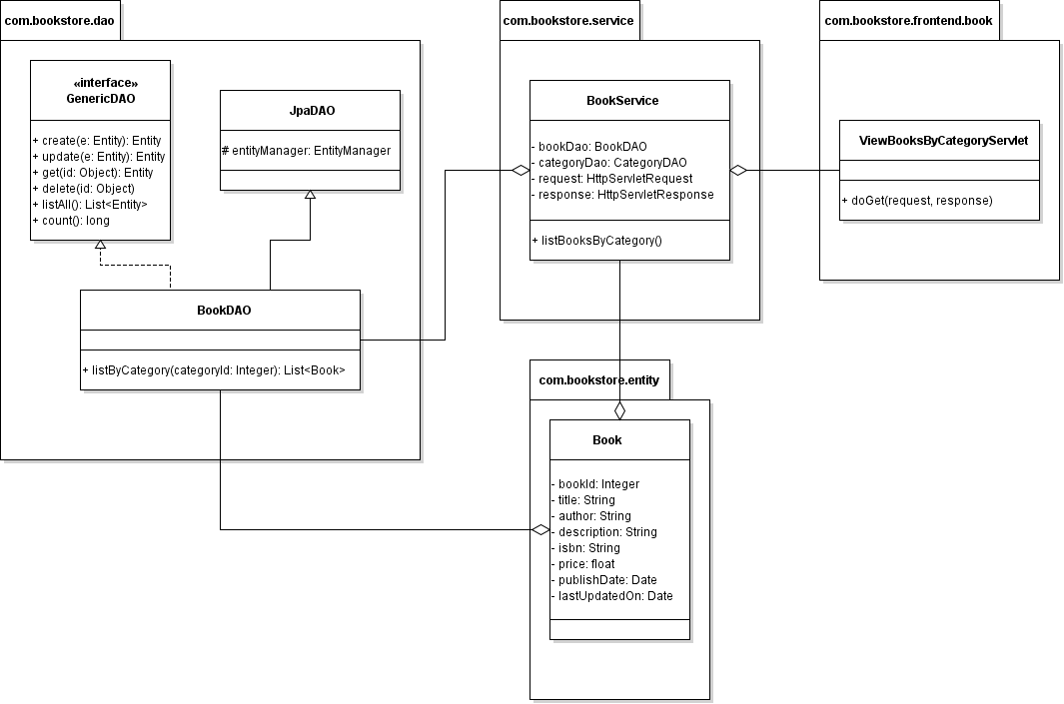
Class Diagram

Slide 8
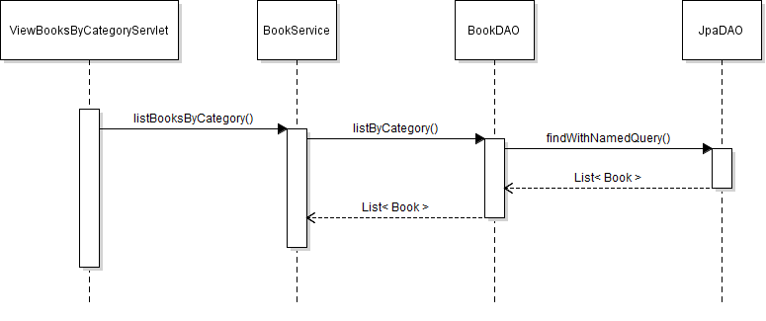
Sequence Diagram

Slide 9
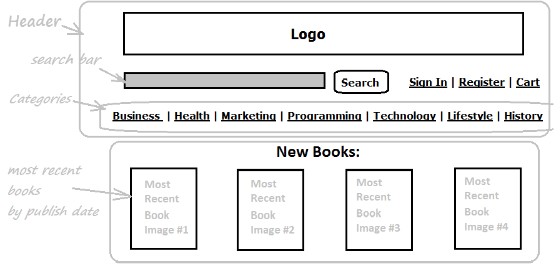
Implement List New Books in Home Page

Slide 10
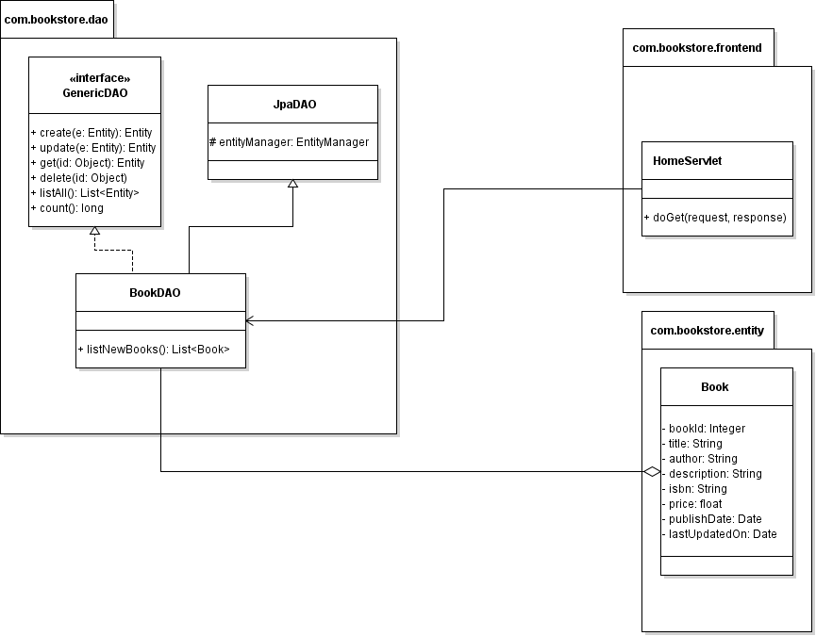
Class Diagram

Slide 11
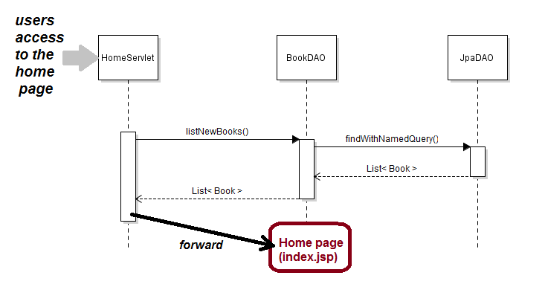
Sequence Diagram

Slide 12
Implement List New Books in Home Page
Task List:
Implement listNewBooks() method in BookDAO + Write Unit test
Update HomeServlet
Update Home Page (index.jsp)

